Slide 1
Android 02 – Basic UI and Events Handling
ITP4203 Object Oriented Mobile Programming

Slide 2

Basic UI Development for Android Applications

Slide 3
Android UI Overview
All user interface elements in an Android app are built using View and ViewGroup objects.
A View object (e.g. Button, TextView) draws something on the monitor and lets user to interact with.
A ViewGroup object (e.g. LinearLayout) can hold other View (and/or ViewGroup) objects for the layout of UI.

Slide 4
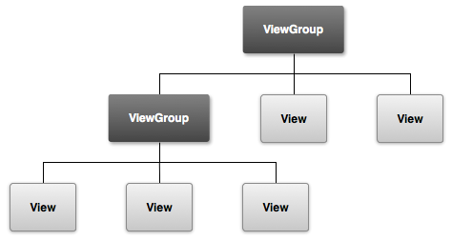
Hierarchy of View and ViewGroup

Slide 5
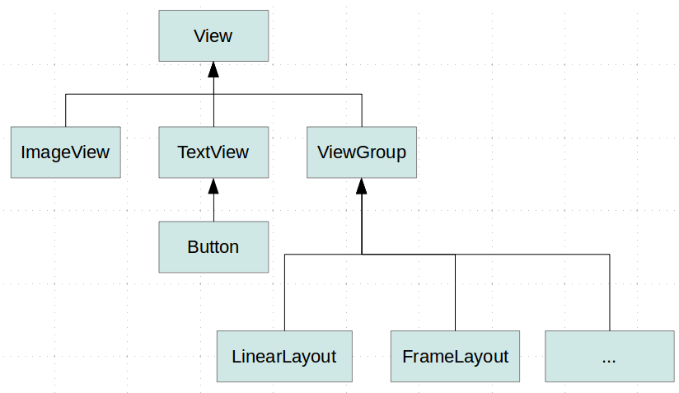
The View class and its subclasses
Link with java object tView1 and UI object textView1:
tView1 = findViewById(R.id.textView1);
(Source from: http://www.vogella.com/tutorials/AndroidCustomViews/images/xandroid_viewhierarchy10.png.pagespeed.ic.nQTkkQQ3Y8.png )

Slide 6
Linear Layout
LinearLayout can align all its children View / viewGroup in direction of vertically or horizontally (default).
Such layout direction can be set with the android:orientation attribute.
android:orientation = "vertical"
android:orientation = "horizontal"

Slide 7
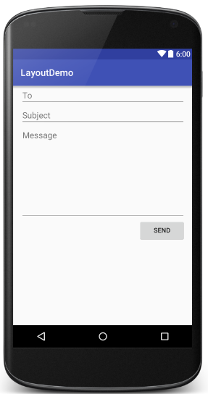
Example : Vertical Linear Layout
<?xml version="1.0" encoding="utf-8"?> <LinearLayout xmlns:android="http://schemas.android.com/apk/res/android" android:layout_width="match_parent" android:layout_height="match_parent" android:paddingLeft="16dp" android:paddingRight="16dp" android:orientation="vertical" > <EditText android:layout_width="match_parent" android:layout_height="wrap_content" android:hint="To" /> <EditText android:layout_width="match_parent" android:layout_height="wrap_content" android:hint="Subject" /> <EditText android:layout_width="match_parent" android:layout_height="200dp" android:gravity="top" android:hint="Message" /> <Button android:layout_width="100dp" android:layout_height="wrap_content" android:layout_gravity="right" android:text="Send" /> </LinearLayout>

Slide 8
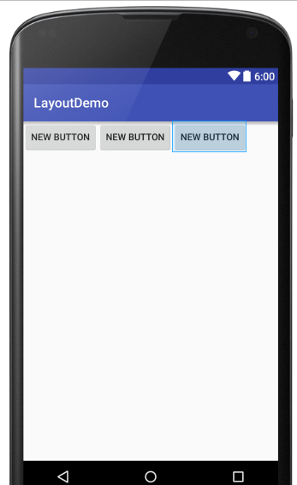
Example : Horizontal Linear Layout
<?xml version="1.0" encoding="utf-8"?>
<LinearLayout xmlns:android="http://schemas.android.com/apk/res/android"
android:layout_width="match_parent"
android:layout_height="match_parent"
android:orientation="horizontal">
<Button
android:layout_width="wrap_content"
android:layout_height="wrap_content"
android:text="New Button"
android:id="@+id/button1" />
<Button
android:layout_width="wrap_content"
android:layout_height="wrap_content"
android:text="New Button"
android:id="@+id/button2" />
<Button
android:layout_width="wrap_content"
android:layout_height="wrap_content"
android:text="New Button"
android:id="@+id/button3" />
</LinearLayout>

Slide 9
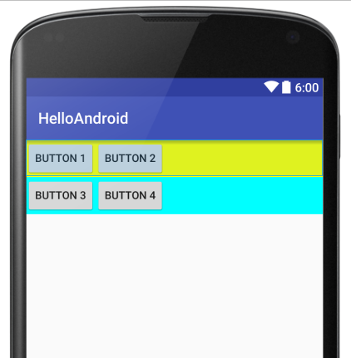
Example : Nested Layout
<?xml version="1.0" encoding="utf-8"?>
<LinearLayout . . . . . .
android:orientation="vertical">
<LinearLayout
android:orientation="horizontal"
android:background="#FFFF00"
android:layout_width="match_parent"
android:layout_height="wrap_content">
<Button . . . . . .
android:text="Button 1" />
<Button . . . . . .
android:text="Button 2" />
</LinearLayout>
<LinearLayout . . . . . .
<Button . . . . . .
android:text="Button 3" />
<Button . . . . . .
android:text="Button 4" />
</LinearLayout>
</LinearLayout>

Slide 10
Constraint Layout
ConstraintLayout is a android.view.ViewGroup which allows you to position and size widgets in a flexible way.
If offers bias values (0-1) to represent the offset in different size of devices.
It can use ratio to adjust the size of view. Eg. app:layout_constraintDimensionRatio=“w,1:1”
It provides chain to group the view as layout.

Slide 11
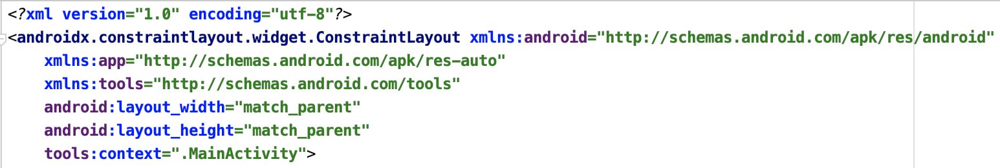
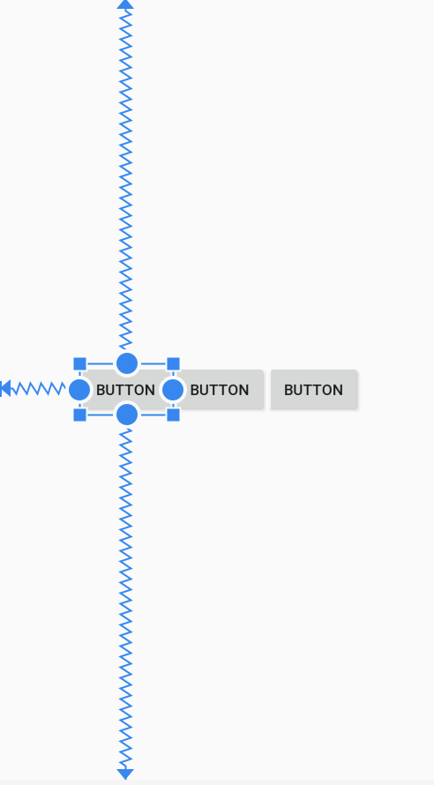
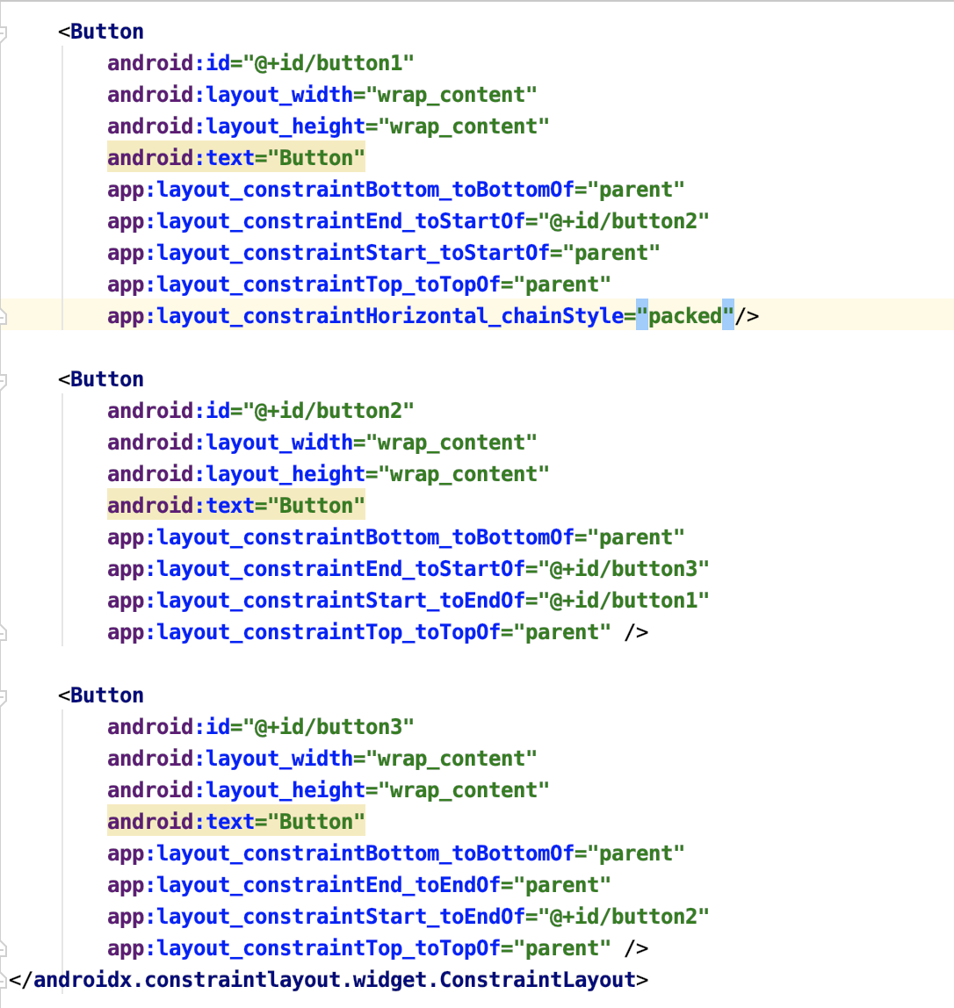
Example

Slide 12
Frame Layout
FrameLayout displays child view on different layers / frames.
A FrameLayout can control child views’ position by assigning gravity to each of them.
android:gravity is a setting used by the View
android:layout_gravity is used by the container (ViewGroup)
left, center, right, top, bottom, center_vertical, clip_horizontal
An ImageView has an attribute, android:scaleType, with 8 values
matrix，fitXY，fitStart，fitCenter，fitEnd，center，centerCrop，centerInside

Slide 13
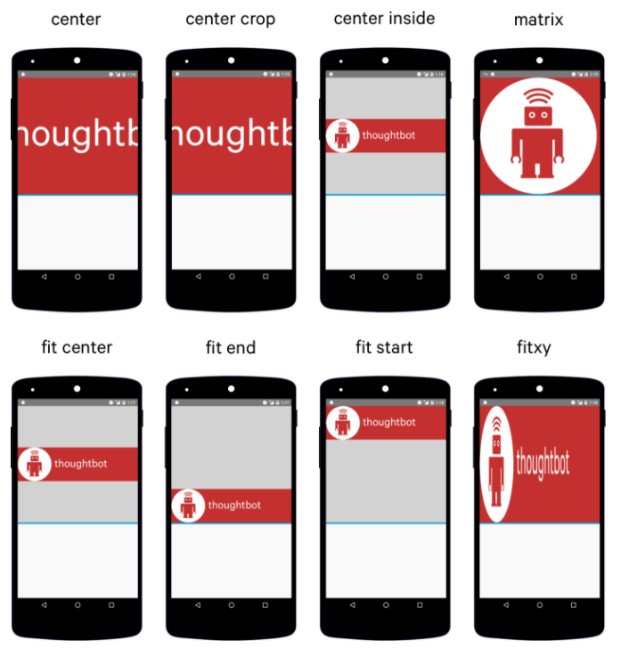
ImageView - android:scaleType
means to maintain the image’s aspect ratio

Slide 14
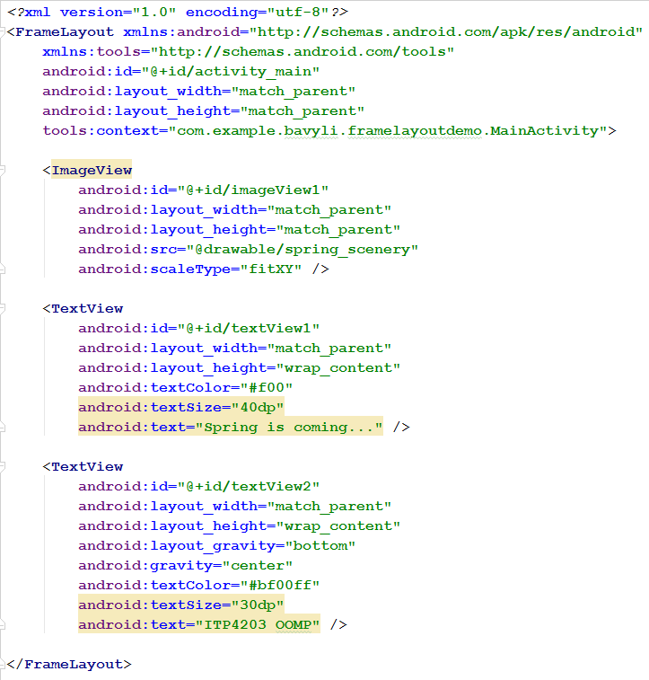
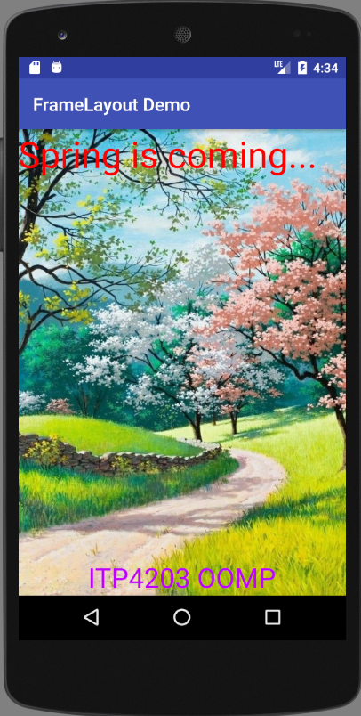
Example: Frame Layout

Slide 15
Table Layout…
TableLayout displays View / viewGroup in rows and columns.
For cells in TableLayout, they can span multiple columns, but cannot span multiple rows. Each row has zero or more cells.
android:stretchColumns (有需要, View物件在指定的column 盡量擴展)
android:shrinkColumns (有需要, View物件在指定的column 盡量收縮)
android:collapseColumns (隱藏指定的column)
Use TableRow to build each row, consider column starts by index 0 (* means for all columns)
android:layout_span
android:layout_column

Slide 16
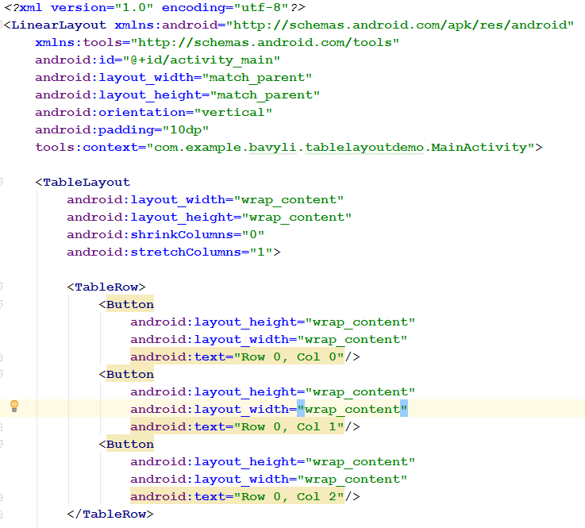
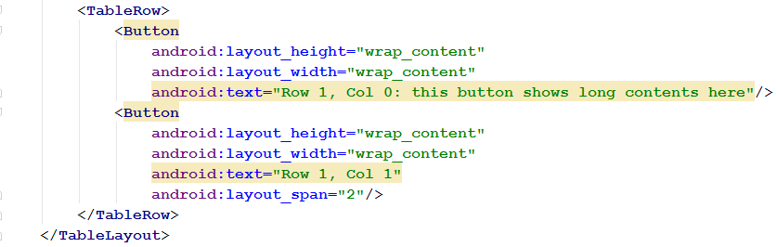
Example: Table Layout

Slide 17
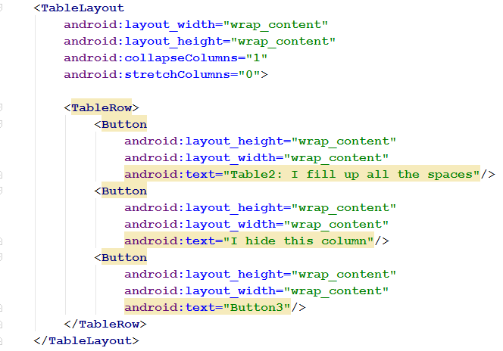
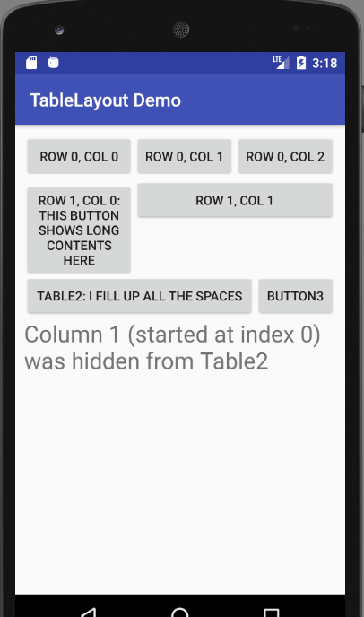
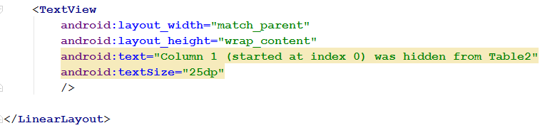
Example: Table Layout (cont.)

Slide 18
Attributes
Every View and ViewGroup object supports their own variety of XML attributes.
Attributes are used to specify the properties of View objects and ViewGroup objects.

Slide 19
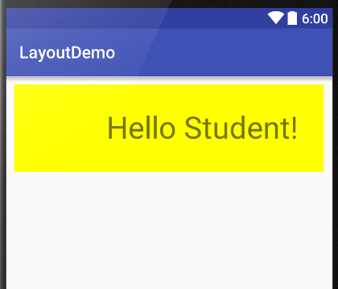
Common Attributes
<?xml version="1.0" encoding="utf-8"?>
<LinearLayout xmlns:android="http://schemas.android.com/apk/res/android"
android:layout_width="match_parent"
android:layout_height="match_parent"
android:orientation="vertical">
<TextView
android:layout_width="match_parent"
android:layout_height="wrap_content"
android:text="Hello Student!"
android:background="#FFFF00"
android:textSize="36sp"
android:layout_margin="10dp"
android:padding="30dp"
android:gravity="right"
android:id="@+id/textView" />
</LinearLayout>

Slide 20
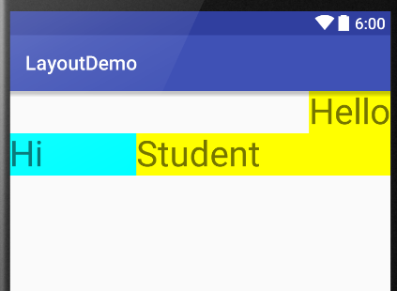
Common Attributes (cont.)
<?xml version="1.0" encoding="utf-8"?>
<LinearLayout . . . . . . android:orientation="vertical">
<TextView . . . . . .
android:layout_width="wrap_content"
android:layout_height="wrap_content“
android:text=“Hello“
android:layout_gravity="right" />
<LinearLayout
android:layout_width="match_parent"
android:layout_height="wrap_content"
android:orientation="horizontal">
<TextView . . . . . .
android:layout_weight="1"
android:layout_width="0dp" />
<TextView . . . . . .
android:layout_weight="2"
android:layout_width="0dp" />
</LinearLayout>
</LinearLayout>

Slide 21
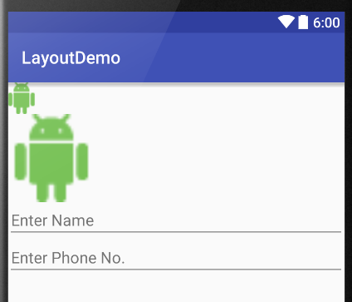
Common Attributes (cont.)
<?xml version="1.0" encoding="utf-8"?>
<LinearLayout . . . . . . >
<ImageView
android:layout_width="wrap_content"
android:layout_height="wrap_content"
android:src="@drawable/android_logo"
android:id="@+id/imageView1" />
<ImageView
android:layout_width="100dp"
android:layout_height="100dp"
android:src="@drawable/android_logo"
android:scaleType="fitCenter"
android:id="@+id/imageView2" />
. . . . . .

Slide 22
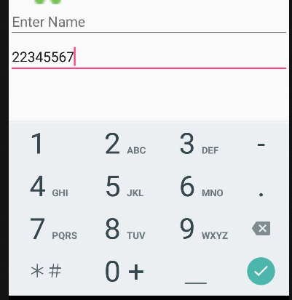
Common Attributes (cont.)
. . . . . . .
<EditText
android:layout_width="match_parent"
android:layout_height="wrap_content"
android:hint="Enter Name"
android:id="@+id/editText1" />
<EditText
android:layout_width="match_parent"
android:layout_height="wrap_content"
android:inputType="phone"
android:hint="Enter Phone No."
android:id="@+id/editText2" />
</LinearLayout>

Slide 23
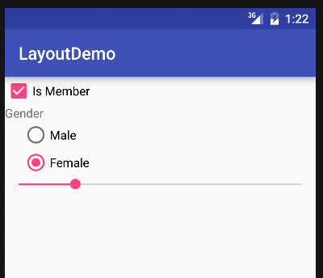
View – CheckBox
<?xml version="1.0" encoding="utf-8"?>
<LinearLayout xmlns:android="http://schemas.android.com/apk/res/android"
android:layout_width="match_parent"
android:layout_height="match_parent"
android:orientation="vertical">
<CheckBox
android:layout_width="wrap_content"
android:layout_height="wrap_content"
android:text="Is Member"
android:id="@+id/checkBox" />
. . . . . .

Slide 24

View – RadioButton
. . . . . .
<TextView . . . . . .
android:text="Gender"/>
<RadioGroup
android:layout_width="wrap_content"
android:layout_height="wrap_content"
android:layout_marginLeft="20dp">
<RadioButton
android:layout_width="wrap_content"
android:layout_height="wrap_content"
android:text="Male"
android:id="@+id/radioButton1" />
<RadioButton
android:layout_width="wrap_content"
android:layout_height="wrap_content"
android:text="Female"
android:checked="true"
android:id="@+id/radioButton2" />
</RadioGroup>
. . . . . .

Slide 25
UI Events Handling

Slide 26
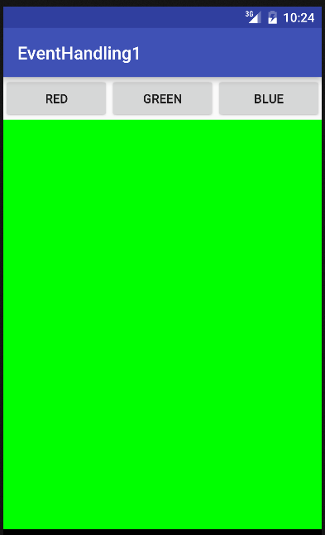
Events Handling
When a user interacts with the UI (e.g. clicking a button), events (e.g. click events) will be fired.
Events will be handled by Listener objects.

Slide 27
View.OnClickListener Interface
public View ... {
public interface OnClickListener {
void onClick(View v);
}
}
The View.OnClickListener Interface is defined in the View class.
An object of type View.OnClickListener is used to handle click events on view objects (e.g. TextView, Button).

Slide 28
Example 1 (Anonymous Inner Class)
public class MainActivity extends AppCompatActivity {
private Button buttonR, buttonG, buttonB;
private TextView textView1;
@Override
protected void onCreate(Bundle savedInstanceState) {
super.onCreate(savedInstanceState);
setContentView(R.layout.activity_main);
buttonR = (Button) findViewById(R.id.buttonR);
buttonG = (Button) findViewById(R.id.buttonG);
buttonB = (Button) findViewById(R.id.buttonB);
textView1 = (TextView) findViewById(R.id.textView1);
buttonR.setOnClickListener( new View.OnClickListener() {
@Override
public void onClick(View v) {
textView1.setBackgroundColor(Color.RED);
}
} );
. . . . . .
An anonymous class is a class with no name.
An inner class is a class defined within another class.
Create an object of the anonymous inner class
Anonymous Inner
Class

Slide 29
Example 1 (cont.)
. . . . . .
buttonG.setOnClickListener(new View.OnClickListener() {
@Override
public void onClick(View v) {
textView1.setBackgroundColor(Color.GREEN);
}
});
buttonB.setOnClickListener(new View.OnClickListener() {
@Override
public void onClick(View v) {
textView1.setBackgroundColor(Color.BLUE);
}
});
}
}

Slide 30
Example 2 (Anonymous Inner Class)
protected void onCreate(Bundle savedInstanceState) {
. . . . . .
View.OnClickListener listener = new View.OnClickListener() {
@Override
public void onClick(View v) {
// Note: v is the view touched by the user
if (v == buttonR)
textView1.setBackgroundColor(Color.RED);
else if (v == buttonG)
textView1.setBackgroundColor(Color.GREEN);
else if (v == buttonB)
textView1.setBackgroundColor(Color.BLUE);
}
};
buttonR.setOnClickListener(listener);
buttonG.setOnClickListener(listener);
buttonB.setOnClickListener(listener);
}
Same “listener” object for all the buttons!

Slide 31
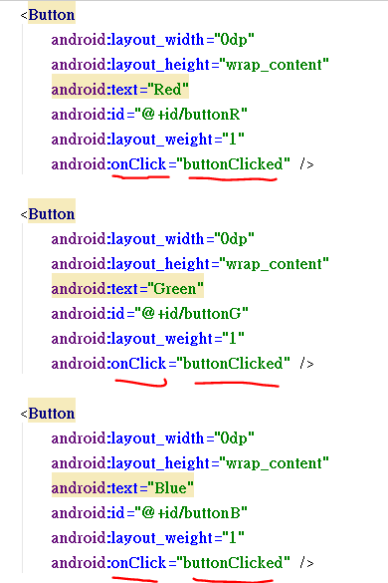
Example 3 (onClick attribute in XML)
public class MainActivity extends AppCompatActivity{
. . . . . .
@Override
protected void onCreate(Bundle savedInstanceState) {
. . . . . .
buttonR = (Button) findViewById(R.id.buttonR);
. . . . . .
// NO NEED to call setOnClickListener( ) here
}
public void buttonClicked(View v) {
if (v == buttonR)
textView1.setBackgroundColor(Color.RED);
else if (v == buttonG)
textView1.setBackgroundColor(Color.GREEN);
else if (v == buttonB)
textView1.setBackgroundColor(Color.BLUE);
}
}

Slide 32
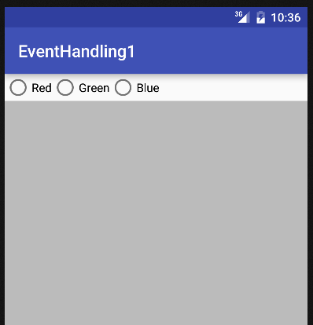
Events Handling (others)
Consider the 3 buttons change to the 3 radio buttons in a RadioGroup
How the events will be handled here?

Slide 33
Event Handling for RadioButton and RadioGroup (1)
<?xml version="1.0" encoding="utf-8"?>
<LinearLayout . . . . . .">
<RadioGroup
android:id="@+id/radioGroup"
android:orientation="horizontal"
android:layout_width="match_parent"
android:layout_height="wrap_content">
<RadioButton
. . . . . .
android:text="Red"
android:id="@+id/radioButtonR" />
<RadioButton
. . . . . .
android:text="Green"
android:id="@+id/radioButtonG" />
<RadioButton
. . . . . .
android:text="Blue"
android:id="@+id/radioButtonB" />
</RadioGroup>
<TextView . . . . ./>
</LinearLayout>

Slide 34
Event Handling for RadioButton and RadioGroup(2)
public class MainActivity extends AppCompatActivity {
private RadioButton radioButtonR, radioButtonG, radioButtonB;
private RadioGroup radioGroup;
private TextView textView1;
@Override
protected void onCreate(Bundle savedInstanceState) {
super.onCreate(savedInstanceState);
setContentView(R.layout.activity_main);
radioGroup = findViewById(R.id.radioGroup);
radioButtonR = findViewById(R.id.radioButtonR);
radioButtonG = findViewById(R.id.radioButtonG);
radioButtonB findViewById(R.id.radioButtonB);
textView1 = findViewById(R.id.textView1);
. . . . . .

Slide 35
Event Handling for RadioButton and RadioGroup (3)
radioGroup.setOnCheckedChangeListener(new
RadioGroup.OnCheckedChangeListener() {
@Override
public void onCheckedChanged(RadioGroup group, int checkedId) {
if (checkedId == R.id.radioButtonR)
textView1.setBackgroundColor(Color.RED);
else if (checkedId == R.id.radioButtonG)
textView1.setBackgroundColor(Color.GREEN);
else
textView1.setBackgroundColor(Color.BLUE);
}
}); //end-of-radioGroup.setOnCheckedChangeListener()
. . . . . .
} // end of onCreate() method
} // end of class MainActivity

Slide 36
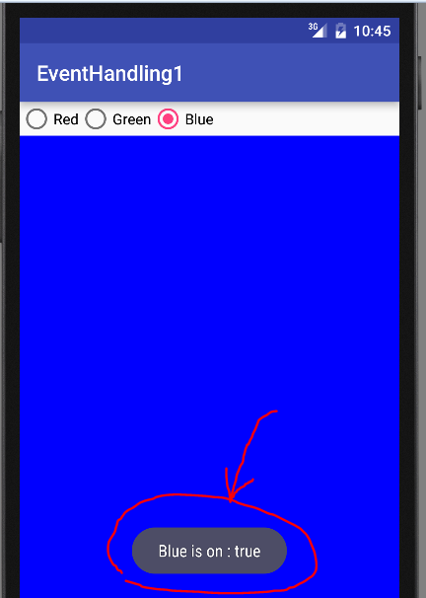
Toast.makeText( 1, 2, 3 ).show();
public class MainActivity extends AppCompatActivity {
. . . . . .
@Override
protected void onCreate(Bundle savedInstanceState) {
. . . . . .
radioButtonB.setOnCheckedChangeListener(new
CompoundButton.OnCheckedChangeListener() {
@Override
public void onCheckedChanged(CompoundButton buttonView,
boolean isChecked) {
Toast.makeText(MainActivity.this,
"Blue is on : " + isChecked,
Toast.LENGTH_LONG).show();
}
}); //end-of-radioButtonB.setOnCheckedChangeListener()
. . . . . .
} // end of onCreate() method
} // end of class MainActivity

